Slide 1
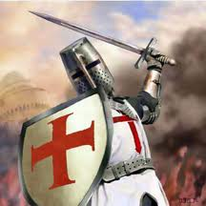
The Grand Master
Issue 1
The annual semi-quarterly (whenever I feel like getting off my bum and writing it) newsletter that brings to your attention articles of interest to you, the casual and competitive wargamer.
And best of all, it FREE!!!
In this issue:
Pic of the Issue
The Grand Masters address
Battlefield humor
Warhammer Fantasy battles articles
B.A.T.T.L.E.D
How to break up your Brettonian units up on how they perform in 8th
Empire Unit Choice
Exposition on how to choose units for your Empire army
Warhammer 40k articles
5th Edition Imperial Guard Codex Troops Review
A comprehensive review of the Troops choices available to the Imperial Guard
Help! I'm new and I can't win! A guide to getting better.
Are you a noob? Read this.
Flames of War articles
Gaming with Partisans in Flames Of War
A compilation of articles on how to use Partisans
Aufklärungsschwadrons in Tunisia and Italy
Information and PDFs for fielding these german recon companies

Slide 2
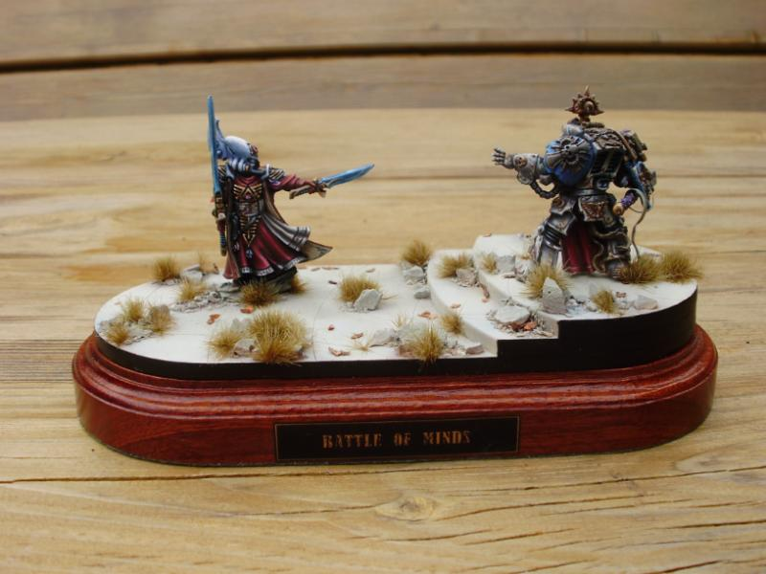
Got some nice Gubbins for sale?
Doing Commissions?
This space is available for a small fee
Simply contact the Grand Master by sending a P.M. to Grey Templar at
http://www.dakkadakka.com/dakkaforum/user/profile/20243.page
Pic of the Issue
This is simply an amazing diorama, the Paint job is exquisite and the scene has such a sense of drama. I can just imagine the struggle of wills between the Grey Knight and the Farseer . Top notch work from SONS of ORAR
Want your Models to be featured? Send me a Photo and it just may be the “Pic of the Issue”
http://www.dakkadakka.com/dakkaforum/user/profile/20243.page

Slide 3
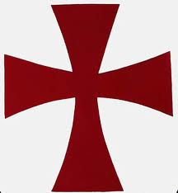
The Grand Masters address
Allow Forge World models and Rules in normal games!!!
it has been a long debate over the years. "do we allow models, and the rules accompanying them, to be used in normal games of 40k or fantasy?"
Now I am not discussing Titans or any other Superheavy vehicle. those are certainly the realm of Apocalypse battles, but rather I am talking about the smaller models like the Cestus Assault Ram, XV9 battlesuits or the Ork Mega dred.
There really are 2 arguments here and there is a right answer to both of them. First, and the only one that makes sense, is the argument against the rules. then there is the argument against the models, but first the rules case.
Most opponents against Forge World models say the rules are unbalanced, favoring the user of the fancy Forge World toy. However that is, most of the time, simply not the case. although Forge World models are nominally powerful this power does come at a premium cost in points. As an example we will look at the rules for Shas'o R'alai.
Here we have a single IC model that carries a very destructive weapon that essentially fires 2 Frag missile blasts(with a better AP) that ignores cover OR an EMP grenade(4-5 glance, 6 Penetrating), OR a Lascannon(with slightly worse AP) OR an Str4, AP4, Rending Large blast. he also has a 4+ invuln save on top of being a battlesuit.
However, this does come with some serious drawbacks. the biggest being the points cost, and the reason Forge World models and rules are not overpowered. he is almost as much as a freaking Landraider, one of the best tanks in the game. also, his weapons have a 15% chance of blowing up in his face. granted with a 3+ armor he won't go down very often, but we all know the dice gods are fickle beings. He will also die to any Force weapon and Str10 that finds its way past his Invuln save.
The last argument many people use, and the one that is just plain stupid, is the argument that the models themselves aren't to be allowed. many say that allowing Forge World models just turns Warhammer into an "Arms race for Nerds" and whoever has the most money wins, or at least has the better looking army. well, this is an expensive hobby without forge world models and therefore already IS an Arms race for Nerds.
Forge World models can be seen as simply scaling up your hobby. if you are willing to pay the extra 20% for a Forge World version of a model or pay more for a unique piece of wargear for your army you deserve to be able to use it in your army. besides, most of the time it will be a disadvantage for you.
The Grand Master has spoken
Let the Grand Master know what you think and send a P.M to Grey Templar on Dakkadakka
http://www.dakkadakka.com/dakkaforum/user/profile/20243.page

Slide 4
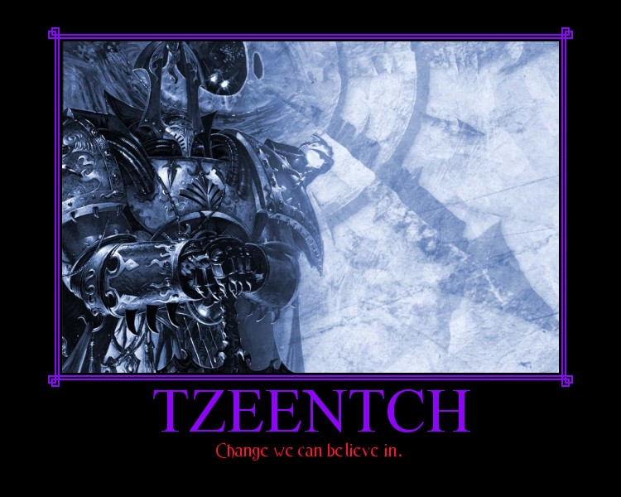
Battlefield humor
A pick me up in the heat of battle
Beware the 7 deadly sins of 40k.
LUST- Obsessive or excessive desires
Your opponent has a fantastically painted brand spanking new Land Raider. Meticulously painted with murals on each side, interior painted, and some fantastic conversion work including a swing arm 'dozer blade...in a word, its beautiful.
He has been talking about it for all 3 of the months he's been working on it, it's his first painted model in the army. A mighty chariot for his commander and terminator entourage to charge your lines with.
....you steal the initiative, fire your first shot, a brightlance, pen, SIX! It's gone. You're opponent is now demoralized for the rest of the 2 hour battle.
How the Emperor will punish you for this sin:
When you get one it will be the model that you will drop, get stolen, leave in your car to melt, or damage during your flight.

Slide 5
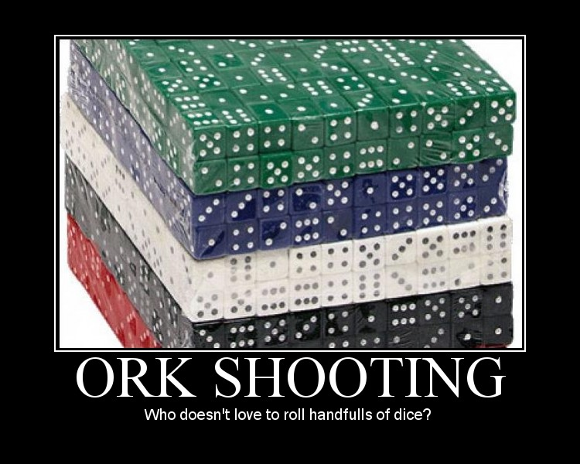
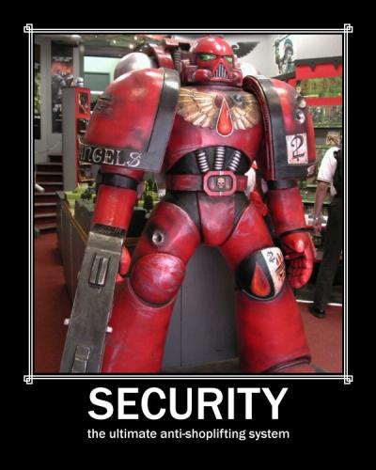

Slide 6
Warhammer Fantasy Articles
B.A.T.T.L.E.D
By Zythaar
How to break up your Brettonian units up on how they perform in 8th
From many centuries, since the wars began the generals cracked their heads on how to defeat the enemy. Many strategies that were wrong costed the lives of thousands of soldiers and ruined the whole countries. The goal of this article is to present you some of the strategies drawn out from the real wars and adapted to the Warhammer Fantasy Battles. With the new edition coming I thought it would begreat to gather up ideas and make a primer for new adepts in the arts of war helping them to learn and understand the basic rules of the battlefield. This article is addressed to people familiar with the rules of WFB although the changes in 8th edition will be explained as they will be discussed.
Read more at
http://www.roundtable-bretonnia.org/index.php?option=com_content&task=view&id=651&Itemid=26
Empire Unit Choice
By unknown author
Exposition on how to choose units for your Empire army
Characters
Templar grand master
Quite simply the best fighter you can get without a special character, with a unit of inner circle knights he will be able to run circles around most units. And with 4 attacks and WS 6 he is best used for killing than leading.
Generals and captains
In a 2000 point match there is no reason why you would take the general over the grand master, unless your playing a defensive force where his leadership 9 will keep your battleline holding. Quite simply never use the general for killing, the grand master does it much better. Captains on the other hand are good choices. At 50 points he is cheap as chips and is able to perform a variety of roles, such as lone character hunting and kill war machine crews. Getting a captain with a battle standard bearer is also a good choice if you want your army to stick around when things go ill.
(However, A General does allow a unit of state troops to carry a 50 point magic banner, which is great for a unit like Greatswords, or perhaps even standard State Troops. He also is the only model that can carry a Runefang)
Read more at
http://www.dakkadakka.com/wiki/en/Empire_unit_choice

Slide 7
Warhammer 40k Articles
5th Edition Imperial Guard Codex Troops Review
By Polonius
A comprehensive review of the Troops choices available to the Imperial Guard
Infantry Platoon
In the recent White Dwarf, Robin stated that the Infantry Platoon is probably the most complicated unit entry in all of 40k. After reading the codex, I have to agree, but really only with the definition of complicated to mean “lots of moving parts.” For anybody with sound intelligence, the Infantry Platoon makes a lot of sense. As the beginning makes clear, a Platoon consists of a Platoon Command squad, 2-5 Infantry Squads, 0-5 Heavy weapon squads, 0-2 Special Weapon Squads, and 0-1 Conscript Platoon. Each unit acts independently but the entire platoon is one choice for deployment and reserves.
The head of the Platoon is the Platoon Command Squad, or PCS, led by the rather drably named “Platoon Commander,” or PC. I suspect many old IG player will continue to call the Platoon Commander a JO, or even a Lieutenant for quite a while. The PCS has many of the options a CCS does, losing the ability to take Camo or Carapce, or a Regimental Standard, or any of the Regimental Advistors, but gaining the ability to add a commissar. In addition, the PCS can only issue a single order at 6”, from the basic list of FRF!SRF!, Move, Move, Move, and Incoming. In terms of sheer abilities, the CCS is far better at only 20pts more, gaining if nothing else two more wounds from the Company Commander, BS4, and the far sexier orders. Of course, the PCS is part of a troops choice and can be taken in frighteningly large numbers, and the reduced cost and abilities don’t matter if you’re using the PCS properly.
First Rank Fire! Second Rank Fire! Adds a shot unto the lasguns in a unit, which heavy weapon teams lose their lasgun and sergeants not longer have the option means that if you use this order squads will once again have almost as many lasgun shots as before. Extra lasgun shots are easy to ignore, but if instead of this order every PCS could shoot 6 S3 shots at either 12” assault or 24” heavy… well, we’d be interested in that, right? Even if only available 55% of the time, 6 more shots is 6 more shots. Never rely on this power, but never forget that it’s available.
Move! Move! Move! A squad that runs gets to roll 3d6 and pick the highest. Huh. Even less obviously useful than FRF!SRF!, this order actually adds a almost two inches to the average run move, from 3.5 to around 5”. This means that a squad moving to claim an objective or set up a better firing lane, or just moving on in Dawn of War, can scoot a little farther. IMO this is the first power to check for good uses of, as the game is won by claiming objectives.
Read more at
http://www.dakkadakka.com/wiki/en/5th_Edition_Imperial_Guard_Codex_Troops_Review_%28Polonius%29

Slide 8
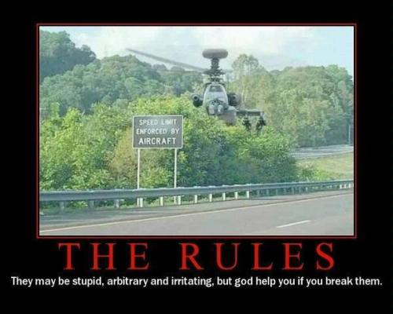
Help! I'm new and I can't win! A guide to getting better.
By anon
Are you a noob? Read this.
Ok first off, you're new to the game. Expecting to win against people who have been playing for years, or even decades, is in many cases pretty unreasonable. However, there are some things you can do to vastly, and quickly, improve your game. Keep in mind the fastest I've ever seen a "noob" really catch up to the better players is about 1 year.
The first thing you need to do is learn the rules. I don't mean read through the rulebook once, then have the local "noobslayer" beat your ass while telling you how to play the game. There are guys out there who like to win so much that they attempt to *only* play against the noobs like you. Don't play against them, because they won't, and even don't want to, help you learn the rules. They also will bend the rules and take advantage of your lack of knowledge of them.
What I mean is, read the rulebook, thoroughly. Then play some games (yes, plural) against a friend with the rulebook open next to you. Every time you move, every time you fire, each time you assault, look up the pertinent rules, read them, and use the charts and protocols given. You'll likely have to be playing against another noob or a friendly opponent, and the games should be small, probably 500-750 points. Enough that all the phases of the game will come into play, but not so much that you feel overwhelmed by the amount of stuff happening on the table.
Read more at
http://www.dakkadakka.com/wiki/en/Help%21_I%27m_new_and_I_can%27t_win%21_A_guide_to_getting_better.

Slide 9
Got some nice Gubbins for sale?
Doing Commissions?
This space is available for a small fee
Simply contact the Grand Master by sending a P.M. to Grey Templar at
http://www.dakkadakka.com/dakkaforum/user/profile/20243.page
Be a sponsor and get your business name out there among the wargaming community
Be a sponsor today and contact us by sending a P.M. to Grey Templar at
http://www.dakkadakka.com/dakkaforum/user/profile/20243.page
Got some nice Gubbins for sale?
Doing Commissions?
This space is available for a small fee
Simply contact the Grand Master by sending a P.M. to Grey Templar at
http://www.dakkadakka.com/dakkaforum/user/profile/20243.page

Slide 10
Flames of War articles
Gaming with Partisans in Flames Of War
A compilation of articles on how to use Partisans
Most Partisan actions on the eastern front were raiding and sabotage
actions, lending the representation of Partisan actions naturally to raiding
games like those introduced with the Sting of the Scorpion and Who Dares Wins boxed sets.
Read more at
http://www.flamesofwar.com/Default.aspx?tabid=108&art_id=419
Aufklärungsschwadrons in Tunisia and Italy
Information and PDFs for fielding these german recon companies
The Aufklärungsschwadron conducts reconnaissance in force, testing the enemy’s positions and exploiting any weak spots they encounter.
The Aufklärungs platoon provides the supporting Panzerspäh platoons with the firepower to punch through the enemy’s lines and begin their reconnaissance. They are always close at hand to flush out enemy infantry or hold down a position on the line while the armoured cars dash for their objective.
Jeeps and motorcycles are equipped with machine-guns to increase the platoon’s firepower while on the move.
Read more at
http://www.flamesofwar.com/Default.aspx?tabid=108&art_id=1954

Slide 11
Legal Disclaimer
This publication is completely unofficial and is in no way endorsed or affiliated with Games Workshop, or Battlefront Miniatures. Warhammer and Warhammer 40k are registered trademarks of Games Workshop Ltd, all associated IP is the property of Games Workshop. Flames of War is a registered trademark of Battlefront Miniatures, all associated IP is the property of Battlefront miniatures. The utmost respect and admiration of their products is held by the Grand Master. May they continue to produce such fine models until the stars turn cold.

